Slide 1
Cross Platform Application Development - ASSIGNMENT -
Person Management System
Prashanth Sagari - 2023tm93669 2023tm93669@wilp.bits-pilani.ac.in

Slide 2

Person Management System
The Person Management System is a Flutter-based mobile application designed to securely manage a list of individuals, allowing authenticated users to perform Create, Read, Update, and Delete (CRUD) operations on person records. The backend is powered by Back4App (Parse Platform), providing seamless user authentication, data storage, and session management. This system ensures a user-friendly interface for managing personal data with built-in validation, search, sorting, and pagination functionalities.

Slide 3

Technology Choice and Tools
Flutter - Cross-platform UI framework for mobile.
Dart - Programming language used with Flutter.
Parse Server SDK for Flutter (parse_server_sdk_flutter) - Connecting to Back4App Handling user sessions, queries, and data manipulation
Back4App (Parse Server backend)
Material Design (Flutter's Material UI components)
Android Studio

Slide 4
Architecture Overview
Frontend: Developed using Flutter, managing UI and logic for user interaction.
Backend (BaaS): Back4App (Parse Server), which handles: User authentication Data storage and retrieval (Person records) Session management and password reset
Flow:
main.dart initializes Parse SDK and sets LoginPage as the entry point.
Authenticated users are redirected to PersonsPage, where CRUD operations are performed on Person objects stored on Back4App.

Slide 5
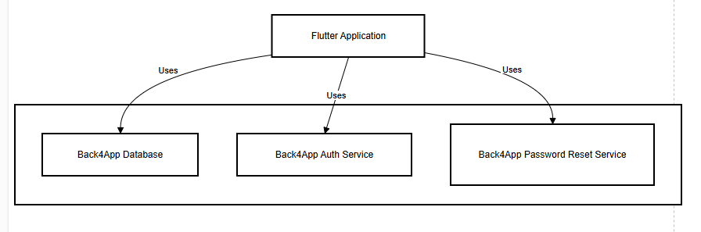
Architecture

Slide 6
User Authentication Flow Using Back4App:
Registration (ParseUser.signUp()):
Takes username, password, and email. Performs client-side validation before attempting sign-up.
Login (ParseUser.login()):
Validates using username and password. On success, user is redirected to PersonsPage.
Password Reset (ParseUser.requestPasswordReset()):
Triggered by user entering their email. Back4App sends a reset link to the registered email.

Slide 7
Back4App Database:
User Class: Built-in class ParseUser with fields: username, password, email
Person Class (Custom): Fields: name: String, age: int, Query Operations:
QueryBuilder is used to fetch Person objects.
Sorting, filtering (by name), pagination, and validation are applied client-side.

Slide 8
While building the Person Management System, I faced a few key challenges. One of the main ones was making sure user authentication with Back4App worked securely and smoothly, which meant handling things like input validation and session management properly. I also had to implement real-time search, sorting, and pagination—all on the client side.

Slide 9
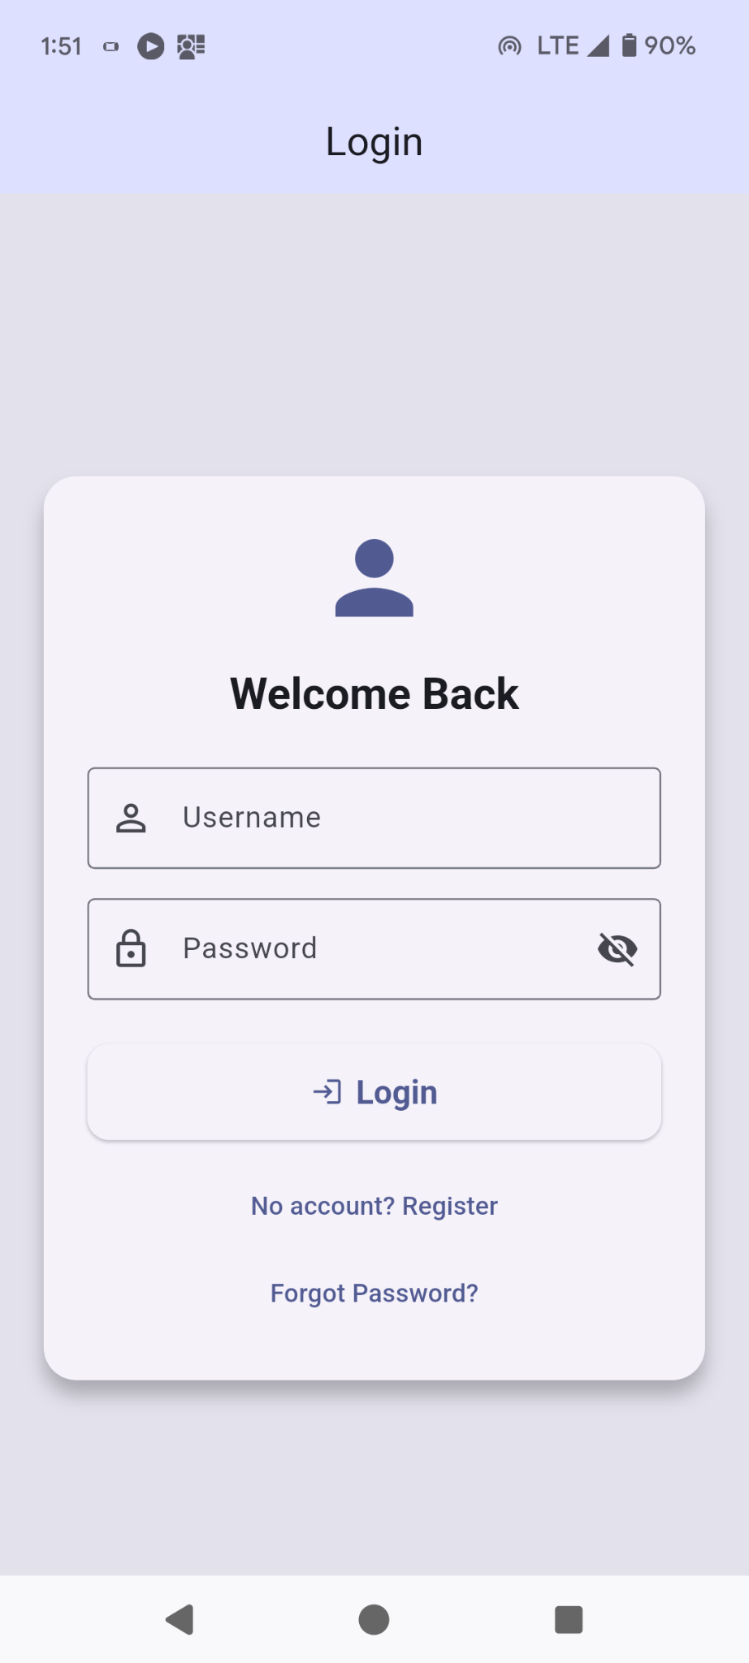
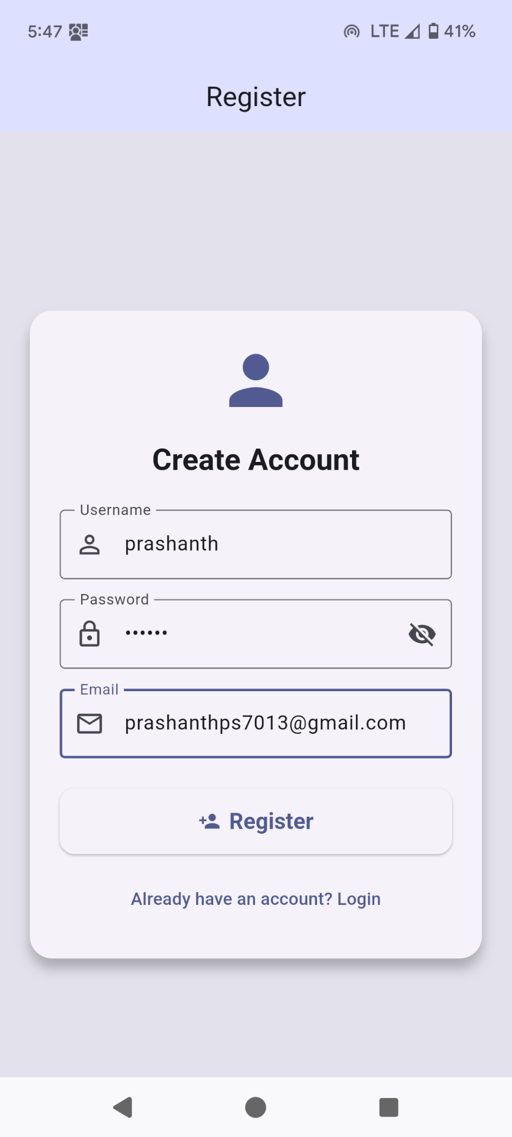

Slide 10
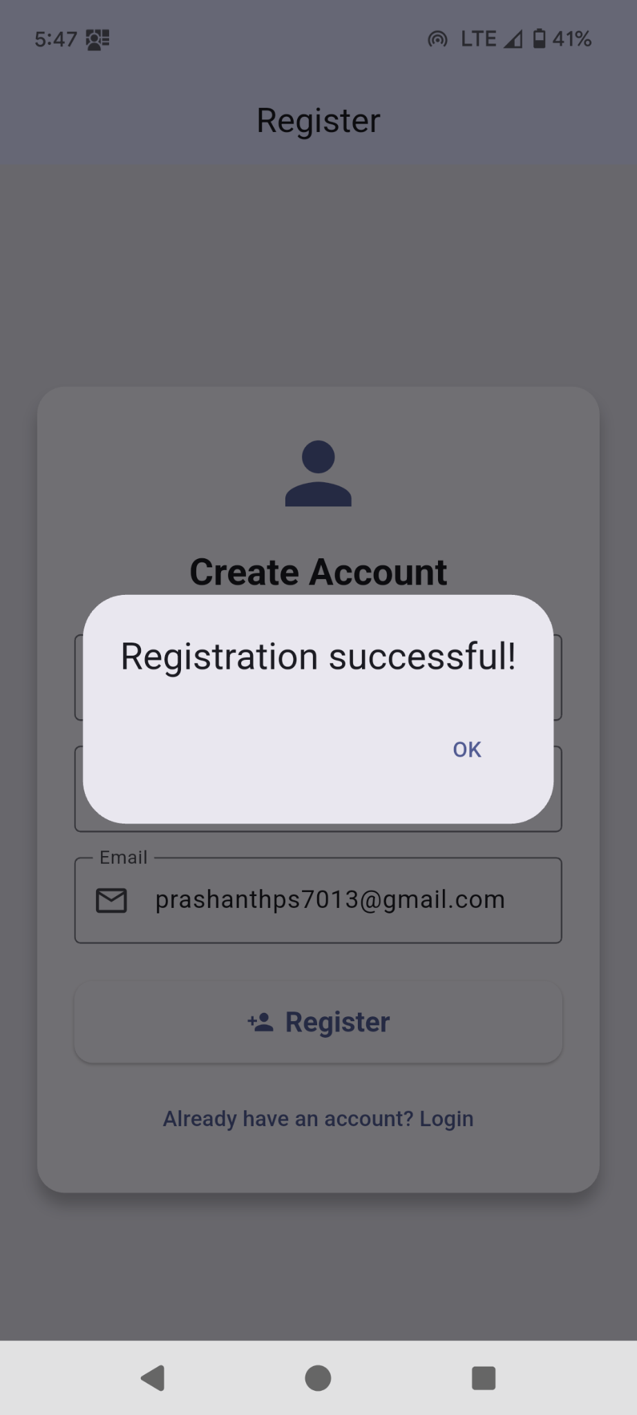
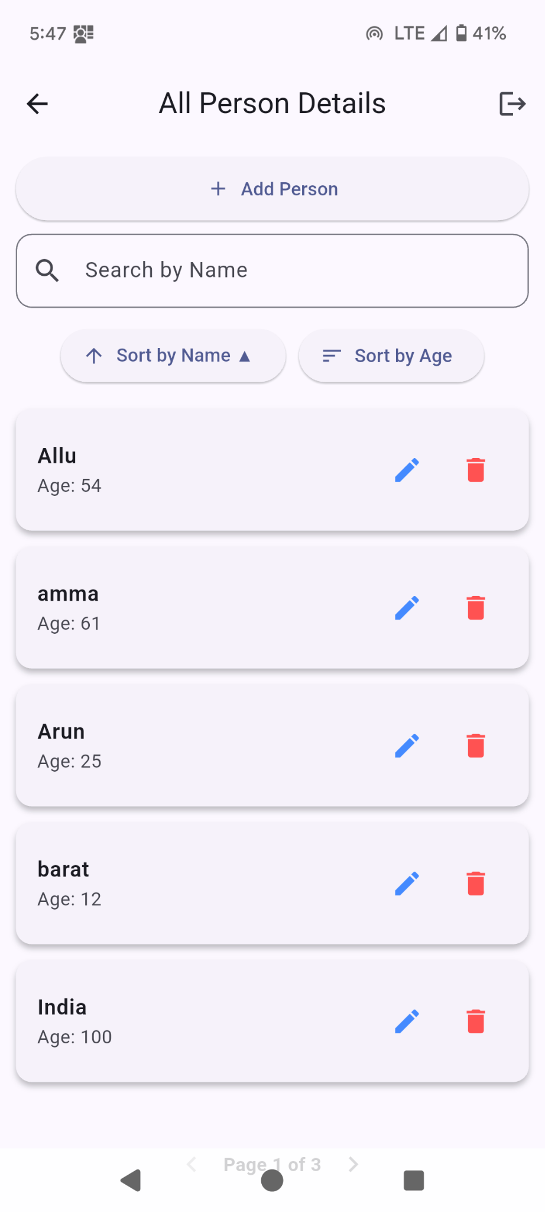

Slide 11
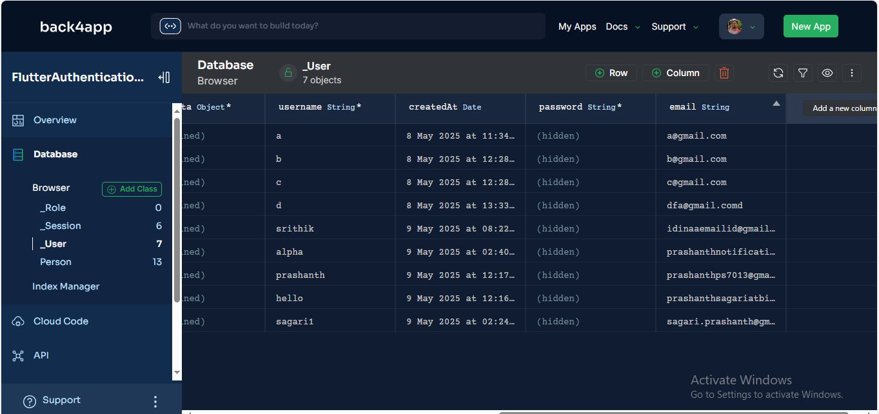

Slide 12
Thank You

